Slide 1



Task Designing with psychtoolbox
Sepideh Khoneiveh
PhD Student of Neuroscience
University Medical Center Hamburg-Eppendorf
Thesis: Recursive Theory of Mind during cooperative and competitive interactions in a social foraging task
s.khoneiveh@uke.de
sepidekh1991@gmail.com
Spring 2024

Slide 2

Topics: Introduction
Understanding Task Design
What is task design in the context of psychological experiments?
Software for Task Design
An overview of the tools and software used in task design.
Principles of Experiment Design
Key considerations and essential elements for designing a robust experiment.
The Importance of Precise Timing
Why accurate timing is crucial in experimental tasks.
Exploring Cognitive Tasks
Examples of cognitive tasks and their applications in research.

Slide 3

Topics: Introduction to Matlab
Getting Started with MATLAB
An overview of MATLAB and its applications.
Navigating the MATLAB Environment
Understanding the MATLAB interface and workspace.
Working with Variables and Data Types
An introduction to variables and the different data types in MATLAB.
Matrix and Vector Operations
Basic operations with matrices and vectors.
Conditional Statements: If-Else
Implementing decision-making with if-else conditions.
Using For Loops
Iteration and repetitive tasks using for loops.
Reading and Writing Data
How to read from and write data to various formats.

Slide 4
Topics: Task designing with psychtoolbox
Installing Psychtoolbox
What are the challenges? What do we need?
Understanding Monitor Functionality
How monitors work and their role in task design.
Drawing Basic Shapes and Lines
Creating and manipulating basic visual elements.
Displaying Text
Techniques for presenting text in experiments.
Working with Images
How to integrate and display images.
Incorporating Voice
Using audio elements in tasks.

Slide 5
Topics: Task designing with psychtoolbox
Handling Mouse and Keyboard Inputs
Capturing and utilizing user inputs from mouse and keyboard.
Integrating Video
Adding and controlling video elements.
Where and how we put the triggers?
Why its so important?
Project Development
Applying the learned skills to create a comprehensive project

Slide 6

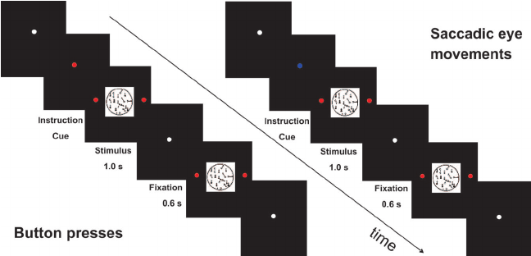
Understanding Task Design
in the context of psychological and neuroimaging research refers to the process of creating structured activities or experiments that participants perform during a study. These tasks are carefully designed to elicit specific cognitive, emotional, or behavioral responses, allowing researchers to investigate various aspects of brain function and behavior.

Slide 7
Understanding Task Design
studying the mental processes
tasks:
passive
Passive tasks involve minimal active engagement from the participant. In these tasks, participants are typically instructed to observe or listen to stimuli without making explicit responses or performing specific actions.
active
Active tasks require participants to engage actively with the stimuli by making decisions, performing actions, or providing responses. These tasks often involve higher cognitive processes and motor actions.

Slide 8
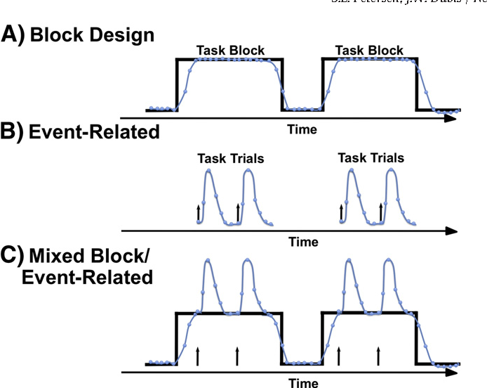
Understanding Task Design
Experimental Design
Block Design
Group similar trials together in blocks. This is useful for tasks requiring sustained attention or for enhancing the signal-to-noise ratio in neuroimaging data.
Event-Related Design:
Present stimuli as discrete, isolated events with variable intervals. This design is flexible and allows for the study of transient processes.
Mixed/Hybrid Design:
Combine elements of both block and event-related designs to leverage the advantages of each.
The mixed block/event-related design https://doi.org/10.1016/j.neuroimage.2011.09.084

Slide 9
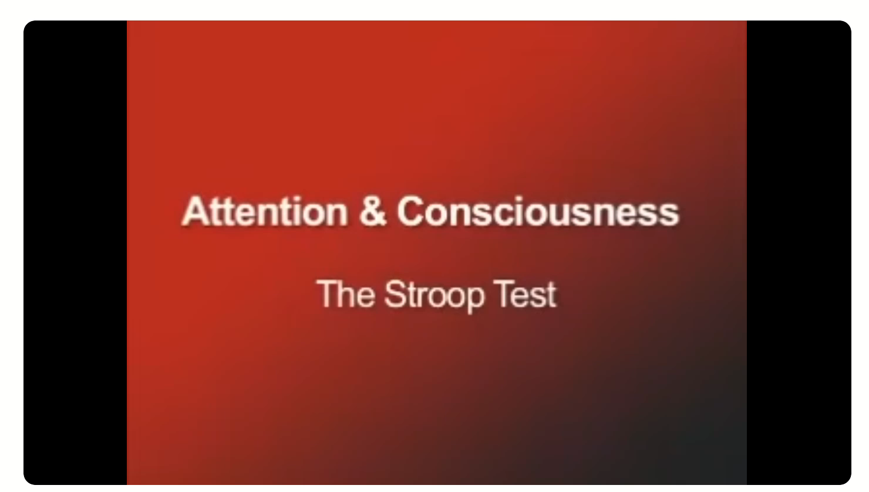
Exploring Cognitive Tasks
Stroop Task:
Description: Participants are shown words that represent colors (e.g., "red", "blue", "green") printed in different colors, and they must name the color of the ink rather than the word itself.
Purpose: Measures cognitive control and interference, examining how automatic processes (reading) can interfere with controlled processes (color naming).
The Stroop Task: The "Gold Standard" of Attentional Measure 10.1037/0096-3445.121.1.12

Slide 10
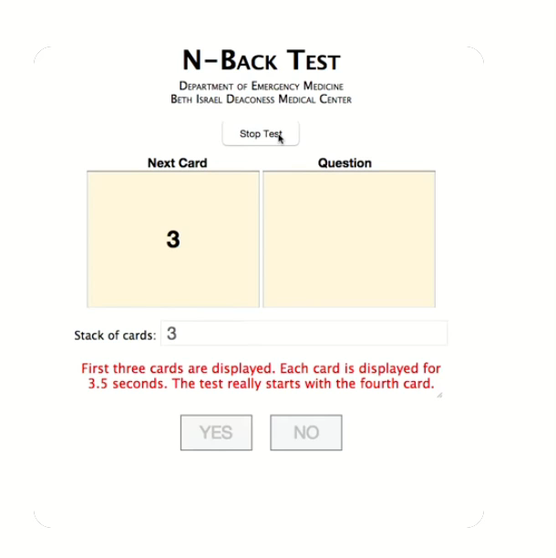
Exploring Cognitive Tasks
N-Back Task:
Description: Participants are presented with a sequence of stimuli (e.g., letters or numbers) and must indicate when the current stimulus matches the one from n steps earlier in the sequence.
Purpose: Assesses working memory and attention.
https://psycnet.apa.org/doi/10.1037/h0043688

Slide 11
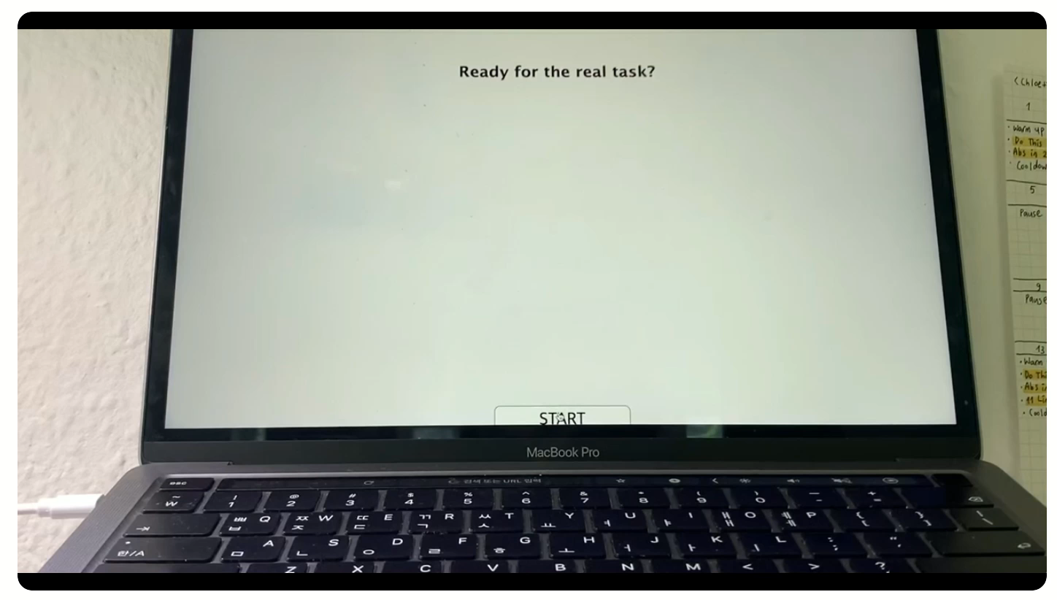
Exploring Cognitive Tasks
Go/No-go Task
Description: Participants are required to respond quickly to certain stimuli (go) and withhold their response to others (no-go).
Purpose: Measures response inhibition and control.

Slide 12
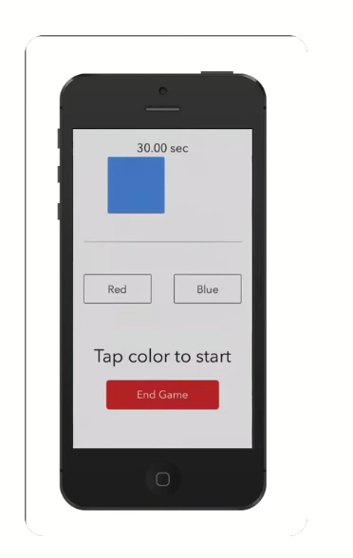
Exploring Cognitive Tasks
Simon Task
Description: Participants respond to the color of a stimulus while ignoring its location, even though the location can influence their reaction time.
Purpose: Examines the effect of spatial congruence on cognitive control.

Slide 13
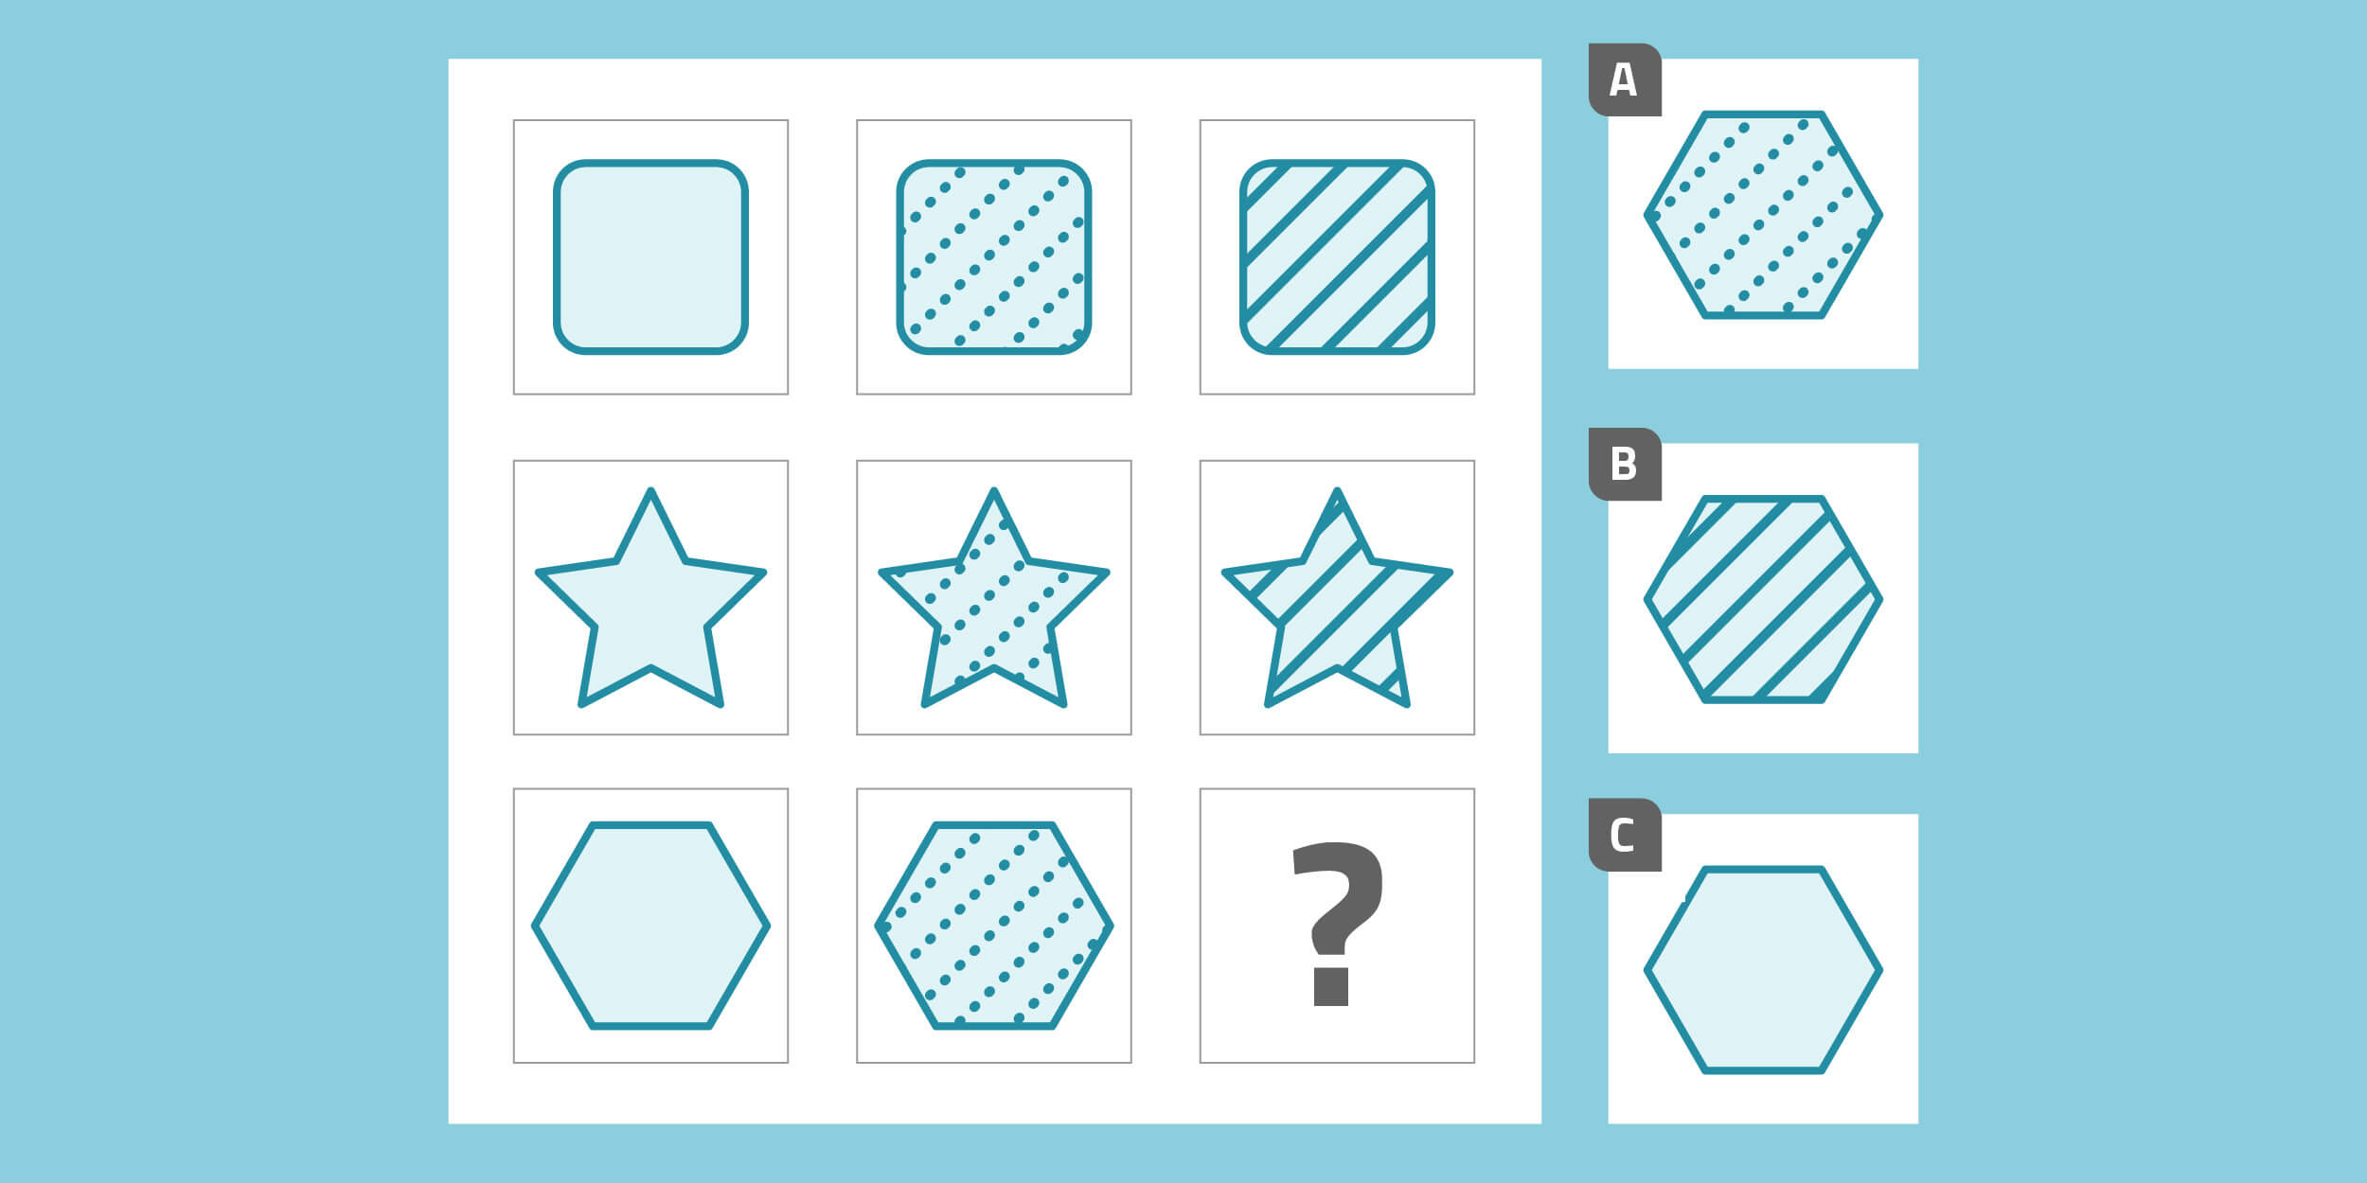
Exploring Cognitive Tasks
Raven Task
Description: Participants are presented with incomplete patterns and must select the piece that completes the pattern from a set of options.
Purpose: Assesses abstract reasoning and non-verbal intelligence.

Slide 14
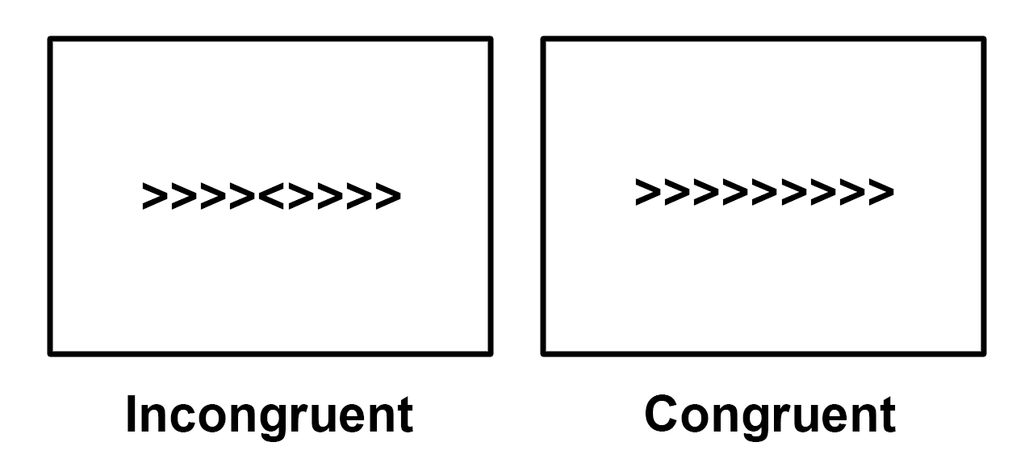
Exploring Cognitive Tasks
Flanker Task
Description: Participants must focus on a central stimulus while ignoring flanking stimuli that can either be congruent or incongruent.
Purpose: Assesses attention and response inhibition.

Slide 15
Principles of Experiment Design
What should we consider when we want to design an experiment?
Objective and Hypotheses (Literature review )
Simplicity (~Complex task)
Stimuli: Decide on the type and nature of stimuli to be presented (visual, auditory, tactile, etc.). Ensure they are appropriate for eliciting the desired responses.
Instructions: Provide clear and concise instructions to participants, ensuring they understand what is expected of them.
Warmup trials!
Control Conditions:
Baseline Condition Include a baseline or rest condition to compare against task-related activity.
Random presentation and Counterbalancing
Pilot Testing!

Slide 16
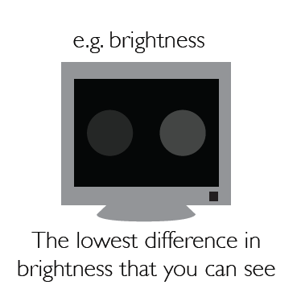
Stimulus Presentation
Screen Characteristics:
Brightness (in the Inter stimulus trials don’t use very bright screen)
Resolution
Refresh Rate :Use a high refresh rate to ensure smooth presentation and accurate timing of stimuli.
Stimulus Presentation Parameters:
Position on Screen
Size of Stimuli
Color Consistency
Monitor Calibration: Calibrate the monitor for color accuracy and brightness using tools like a colorimeter.
Sound Calibration: Use a decibel meter to ensure consistent sound levels for auditory stimuli.
Synchronization: Ensure that the timing of stimulus presentation is accurately synchronized with the experimental software and data recording equipment.
Latency: Minimize latency between the command to present a stimulus and its actual display on the screen.

Slide 17
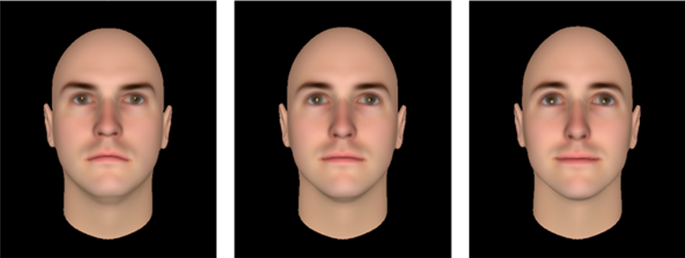
Stimulus Presentation

Slide 18


Slide 19


Slide 20
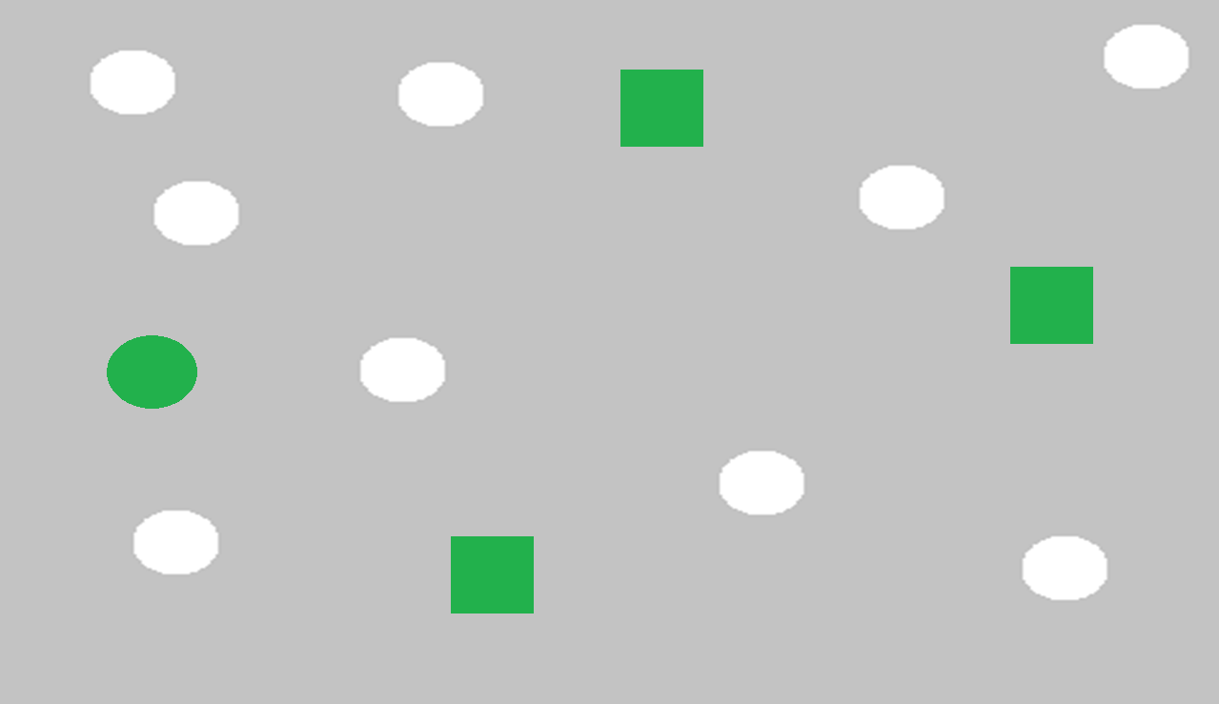

Slide 21
Different Modalities
EEG Study
Stimulus Presentation Timing
Minimizing Artifacts: your task shouldn’t induce extra artifacts.
Baseline and Control Conditions
Event Markers
fMRI Study
TR (Repetition Time): Align stimulus presentation and task timing with the scanner's repetition time (TR). Ensure that the timing of events (stimuli, responses) fits within the acquisition schedule.
Slice Timing: Account for the timing of slice acquisition within each TR, as the signal from different brain regions is acquired at slightly different times.
Block Design: Group similar trials together in blocks (e.g., 20 seconds of one condition followed by 20 seconds of another) to increase the signal-to-noise ratio.
Baseline and Control Conditions
Event-Related Design
Visual Stimuli: Use MRI-compatible goggles or a screen. Ensure clear visibility and comfortable viewing position.
Auditory stimuli: Make sure the participant can hear the stimuli inside of the scanner!!
Multimodalities
All the devices should start recording at the same time or your trigger should cover all of the modalities (EEG, fMRI, TMS, EMG, eye-tracking ,…)

Slide 22
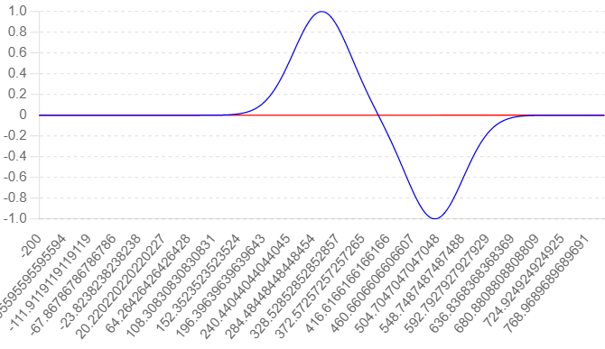
The Importance of Precise Timing
What is Lag ?
Lag refers to a delay between a stimulus presentation and the participant's response or between different components of the experimental setup. This delay can be intentional (designed into the experiment) or unintentional (due to hardware or software limitations).
Temporal Resolution
Event-Related Potentials (ERPs)
Causal Inferences
Cognitive Processes:
Behavioral Data Integration
**Synchronization with External Devices**

Slide 23
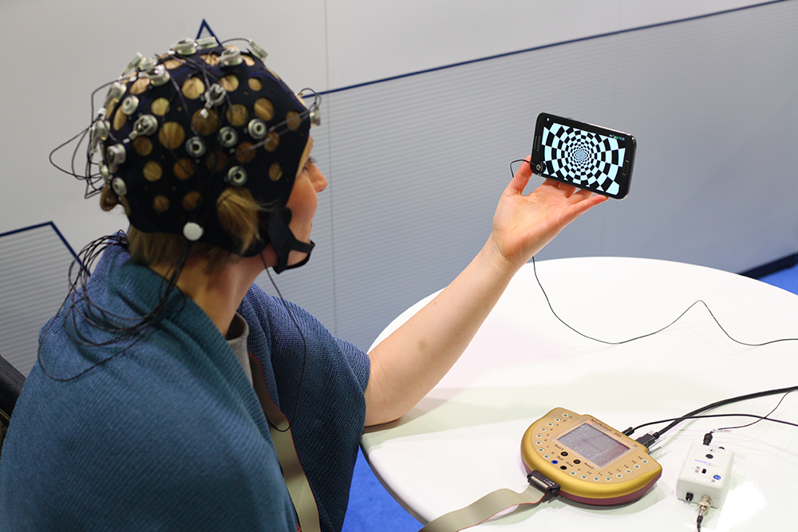
The Importance of Precise Timing
How to Solve this?
High-Quality Software and Hardware
Experiment Design!!
Latency Testing
Event Markers and Logging (parallel or serial trigger, Photodiode, Lab streaming layer )
Lab streaming layer: https://labstreaminglayer.org/#/

Slide 24
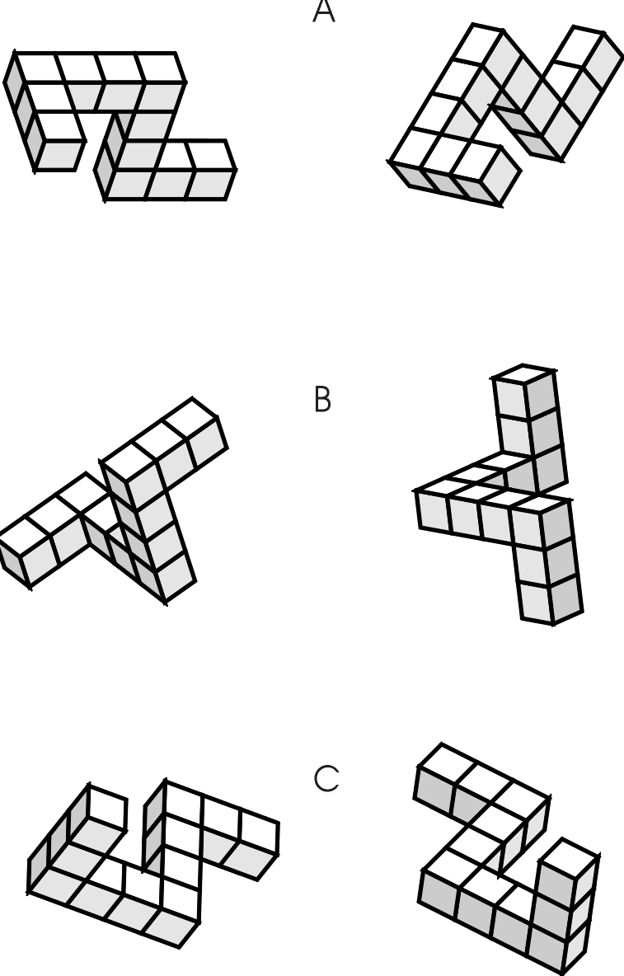
Reaction Time
The time elapsing between the presentation of a stimulus and the onset of the overt response associated with it.
For instance, our knowledge of visual imagery relies heavily on the prediction that reaction times should increase when stimuli are presented at different degrees of angular rotation (Shepard & Metzler, 1971).

Slide 25






Software for Task Design
Psychtoolbox (Matlab): a suite of MATLAB functions for vision and neuroscience research.
(https://www.psychtoolbox.net/)
PsychoPy (Python): an open-source application allowing you to run a wide range of experiments in behavioral sciences. (https://www.psychopy.org/)
E-Prime: a suite of applications for designing and running psychological experiments, particularly in behavioral research. (https://pstnet.com/products/e-prime/)
Presentation: a software package for designing and controlling psychological experiments, known for its precise timing capabilities.
(https://www.neurobs.com/)
OpenSesame (Python): an open-source, graphical experiment builder for the social sciences
(https://osdoc.cogsci.nl/)
SuperLab: software designed for stimulus presentation and experimental design in cognitive and neuropsychology research.
(https://cedrus.com/superlab/index.htm)
LabVIEW: a system-design platform and development environment for a visual programming language, useful in some experimental setups.
SR Research Experiment Builder: a graphical experiment creation tool designed specifically for SR Research eye trackers, but also capable of general experiment design. (https://www.sr-research.com/experiment-builder/)
Gorilla: an online platform for designing, programming, and running behavioral experiments. (https://gorilla.sc/)
Otree (Python): Psychology experiments, Multiplayer games (https://www.otree.org/)

